Slide 1
Fingerprint Lock with LCD Display Computer Architecture
University of Basel, Fall 2024
Luca Fässler, Barththan Sivanantham, Valerio Job

Slide 2
Project Goal
Ambition
To build a secure access system that uses biometric authentication with a fingerprint sensor, controlled by an Arduino, to ensure a secure lock
Secure Access: Biometric system using fingerprint recognition to control entry
Real-Time Feedback: LCD display shows status (e.g., "Access Granted" or "Access Denied")
Modular Design: Easily adaptable for various access control applications

Slide 3
Project Goal
Ambition
To build a secure access system that uses biometric authentication with a fingerprint sensor, controlled by an Arduino, to ensure a secure lock
Secure Access: Biometric system using fingerprint recognition to control entry
Real-Time Feedback: LCD display shows status (e.g., "Access Granted" or "Access Denied")
Time-Based Access: Feature to restrict or allow access based on specific time intervals, enhancing security and operational flexibility
Modular Design: Easily adaptable for various access control applications

Slide 4
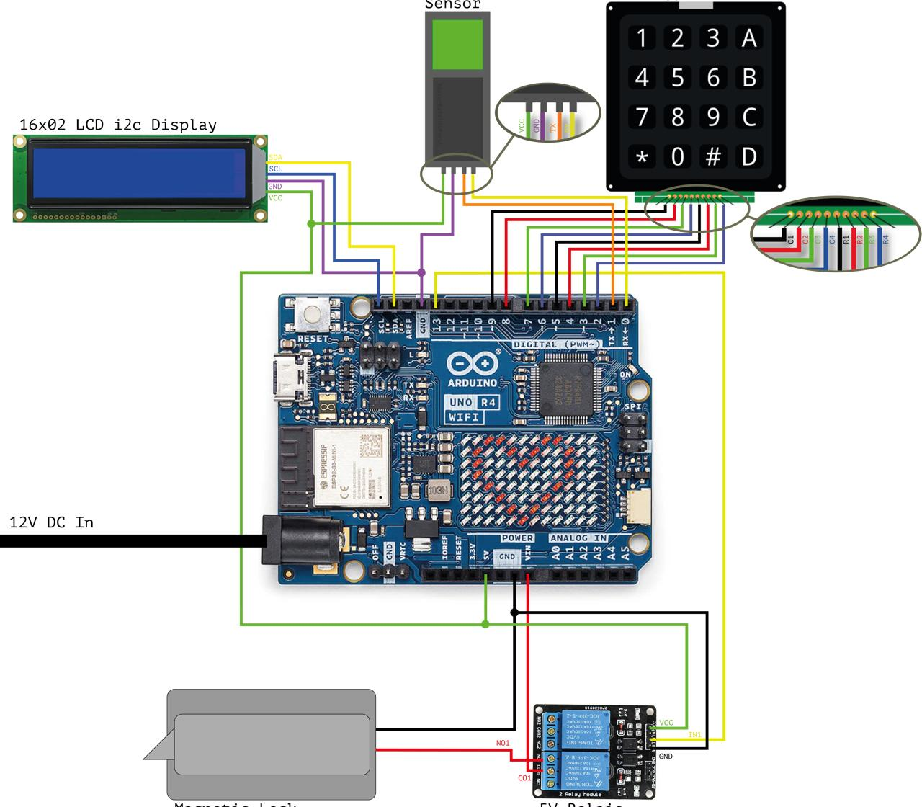
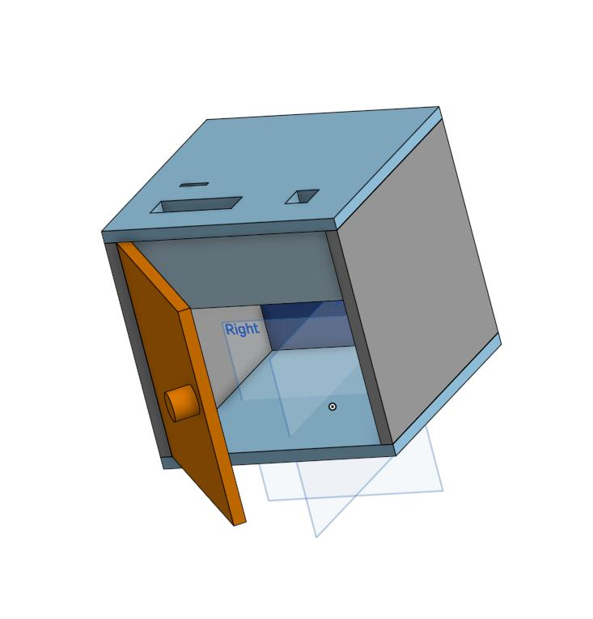
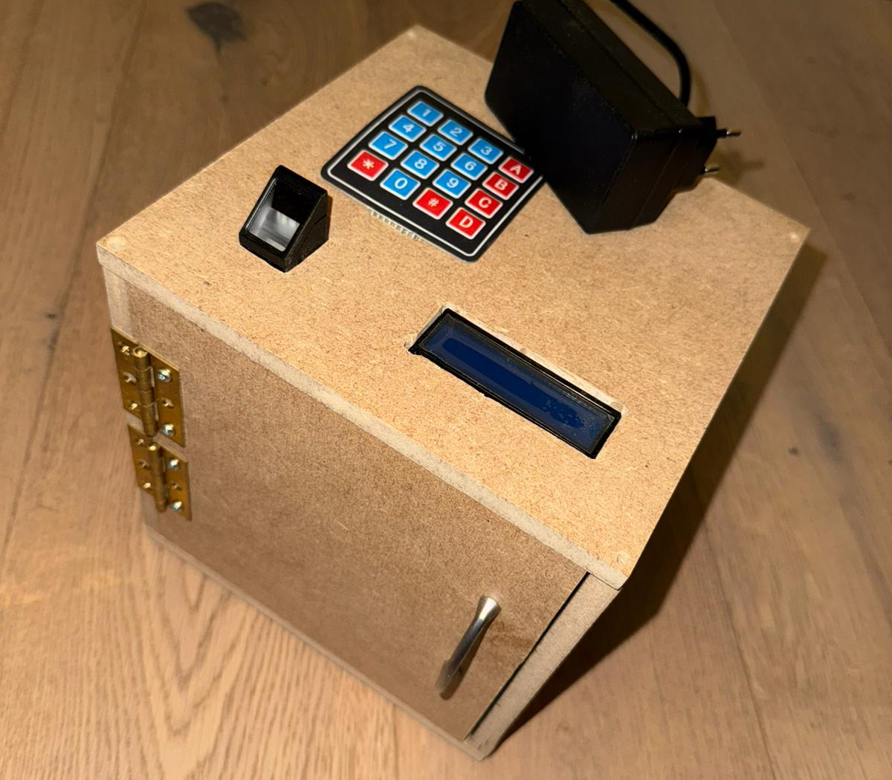
System Overview
Circuit Diagram
CAD Visualization
Final Result

Slide 5
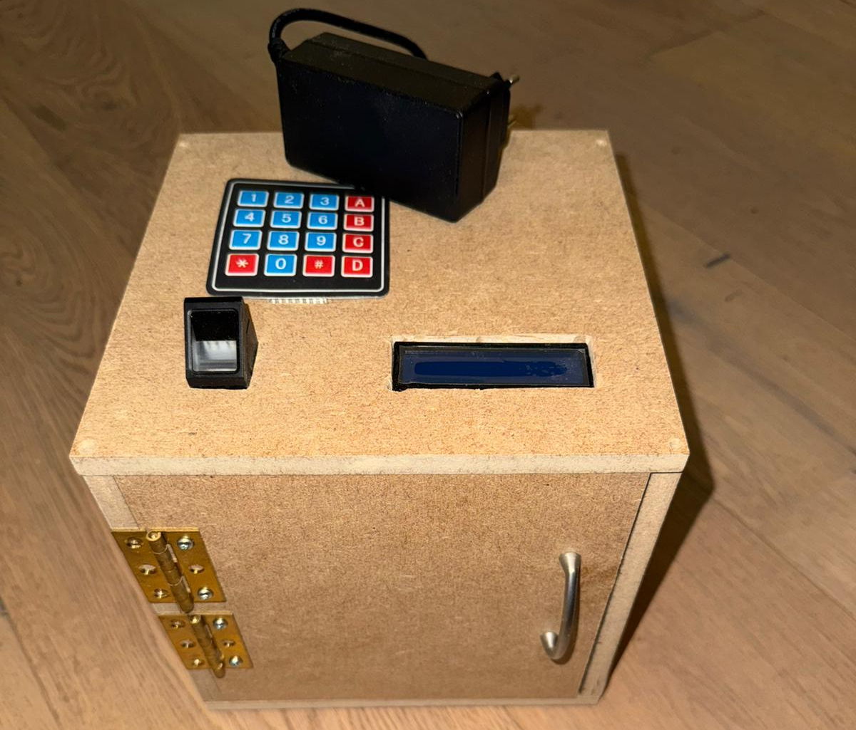
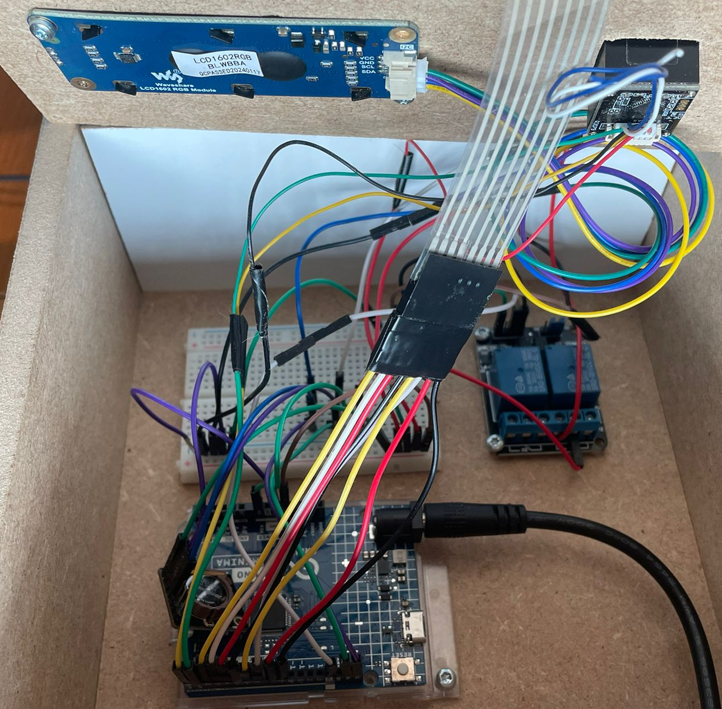
Hardware Implementation
Hardware
Arduino UNO R4 Minima/WIFI
R307 Fingerprint Reader
16x2 I2C LCD Display
12V DC Electromagnetic Lock
2-Channel Relay Module
12V DC Power Supply
Jumper Wires & Breadboard
RTC SD3031
Keypad 4x4 Matrix
Wood, Hinge, Door Handle
Total HW Costs: 236.66 CHF (initially Planned: 106 CHF)

Slide 6
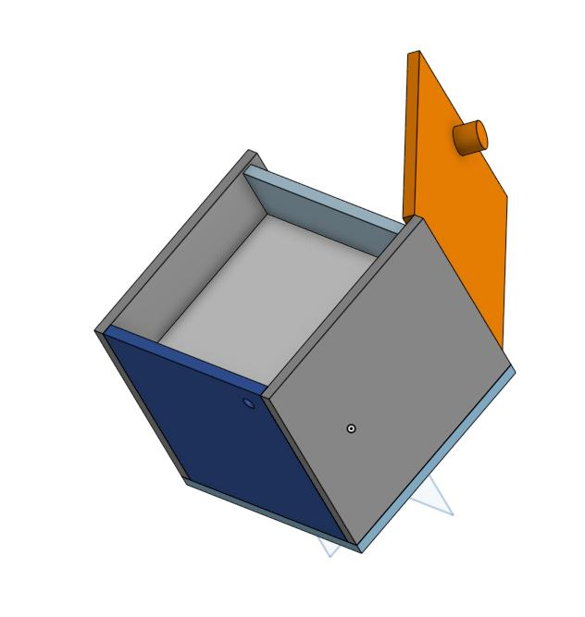
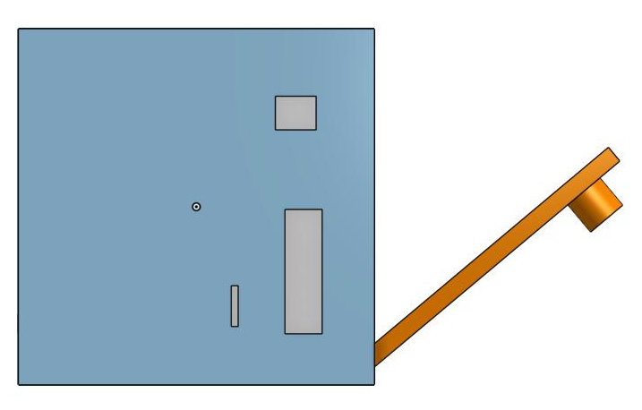
Hardware Implementation
Hardware
Arduino UNO R4 Minima/WIFI
R307 Fingerprint Reader
16x2 I2C LCD Display
12V DC Electromagnetic Lock
2-Channel Relay Module
12V DC Power Supply
Jumper Wires & Breadboard
RTC SD3031
Keypad 4x4 Matrix
Wood, Hinge, Door Handle
Total HW Costs: 236.66 CHF (initially Planned: 106 CHF)

Slide 7
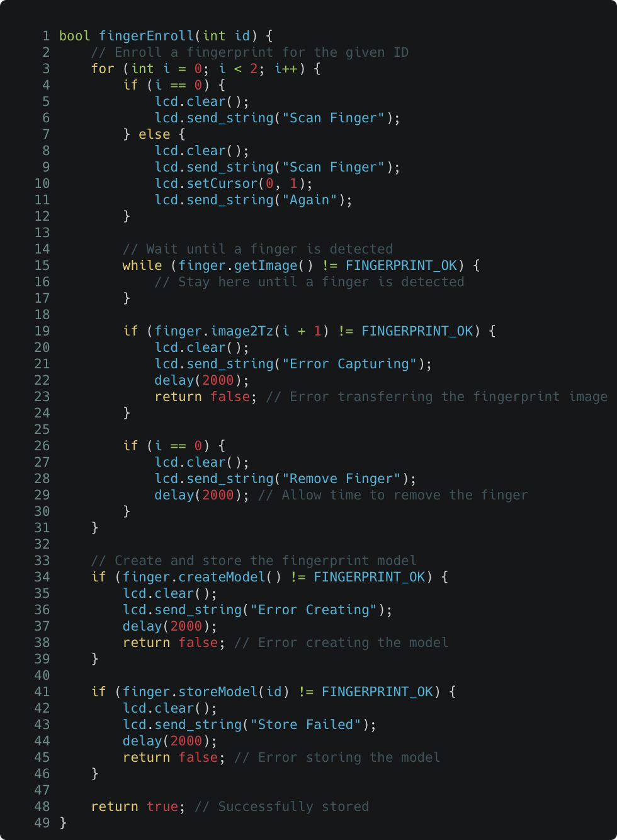
Software Implementation
Programming Environment
Developed using Arduino IDE (C++)
Serial communication for debugging
Core Functionalities
Fingerprint Enrollment and Verification
Time-Based Access Control
Access to predefined time slots
LCD Display Handling
User Feedback Messages
Relay Control
Lock Activation upon Verification and Time

Slide 8
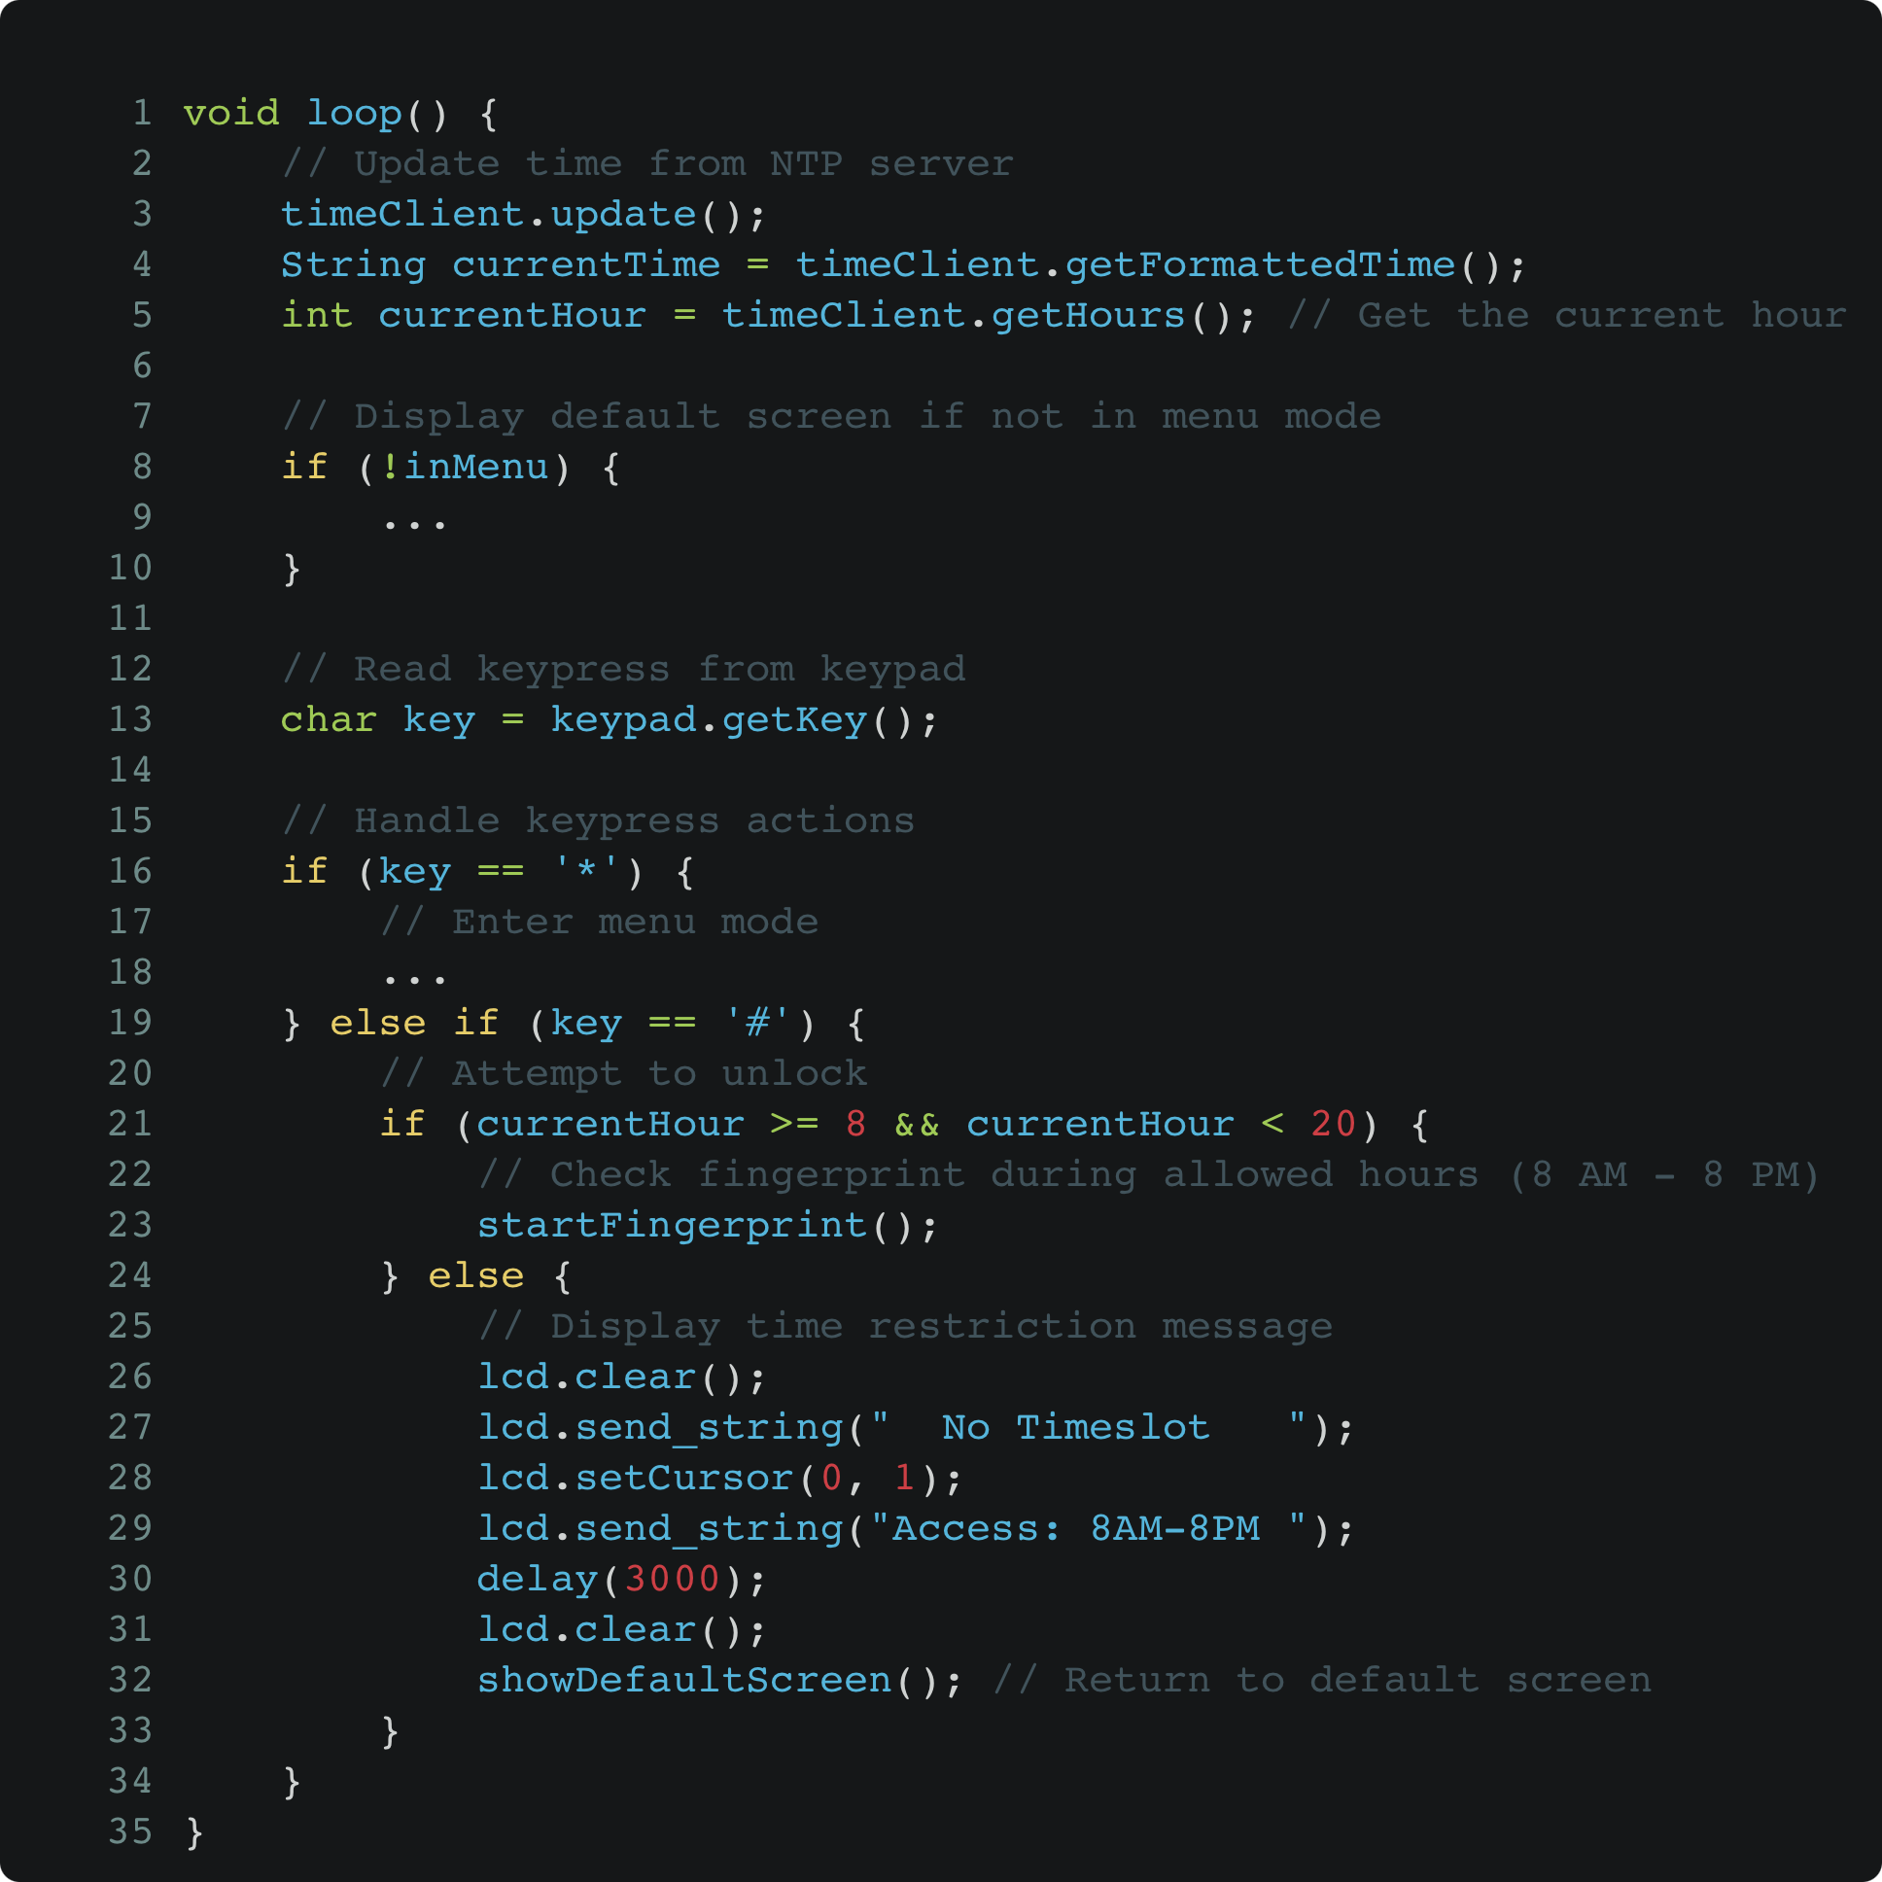
Software Implementation
Programming Environment
Developed using Arduino IDE (C++)
Serial communication for debugging
Core Functionalities
Fingerprint Enrollment and Verification
Time-Based Access Control
Access to predefined time slots
LCD Display Handling
User Feedback Messages
Relay Control
Lock Activation upon Verification and Time

Slide 9
Challenges Faced
Keypad Sensitivity Issues
Problem: Keypad produced ghost inputs and was overly sensitive
RTC Module Challenges
Problem: Difficulties in getting the RTC Module to function correctly
Power Supply Issues
Problem: Wrong power supply caused multiple failures; components stopped working, Arduino board was not recognized by the computer
LCD Backlight Failure
Problem: LCD backlight stopped functioning at full potential
Solution: Switched to a more stable keypad library, which resolved the issue and improved input accuracy
Solution: same as 3.
Solution: Purchased a new Arduino board with a Wi-Fi module, allowing us to fetch time from the network instead of relying on the RTC module
Solution: Replaced the LCD screen with a new one, which resolved the problem

Slide 10
Demo

Slide 11
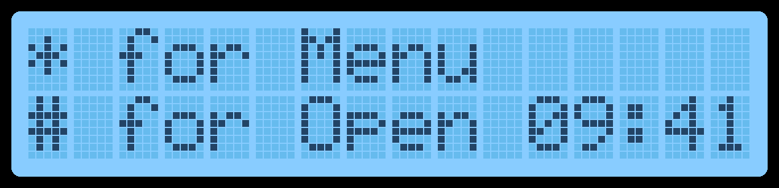
Demo

Slide 12
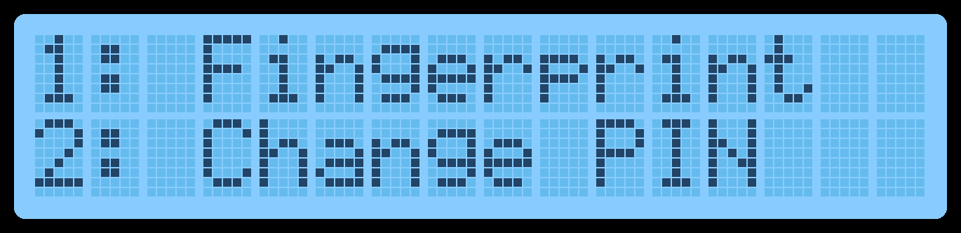
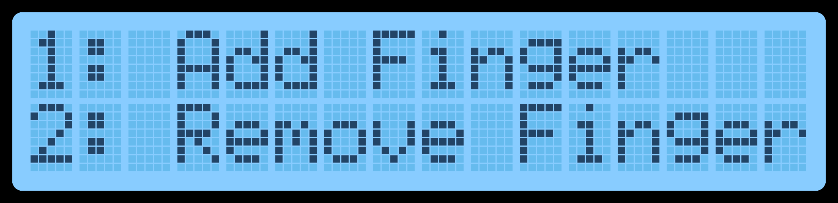
Demo

Slide 13
Demo

Slide 14
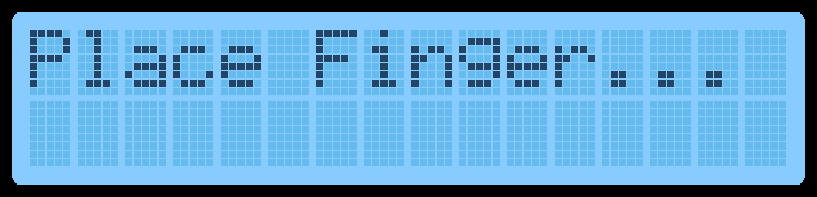
Demo

Slide 15
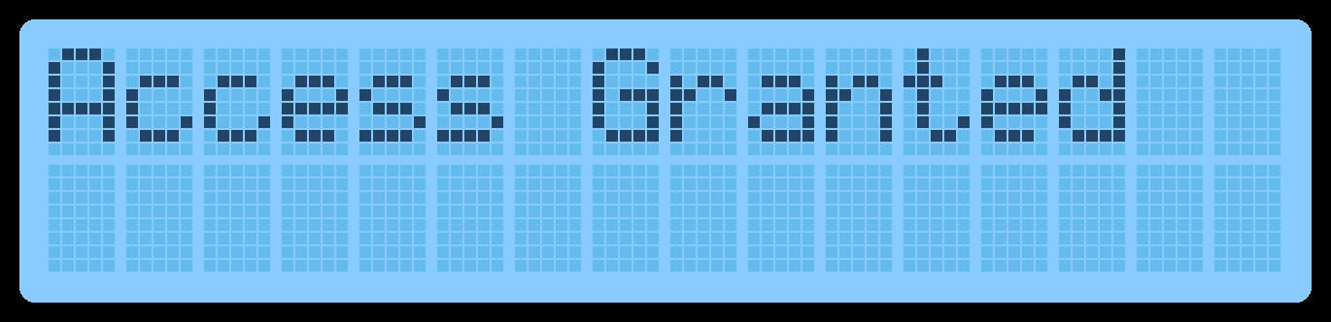
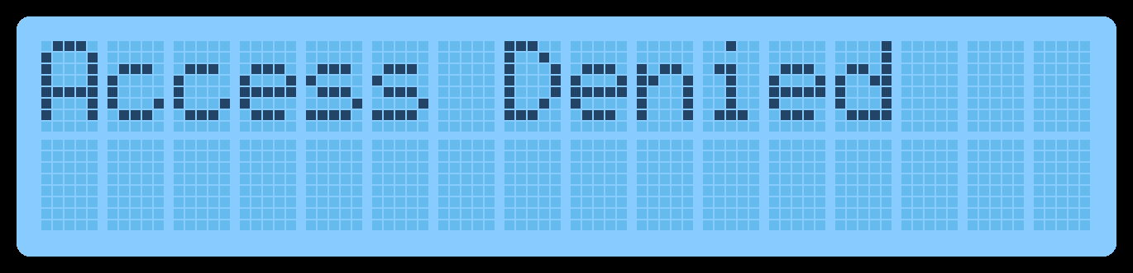
Demo

Slide 16
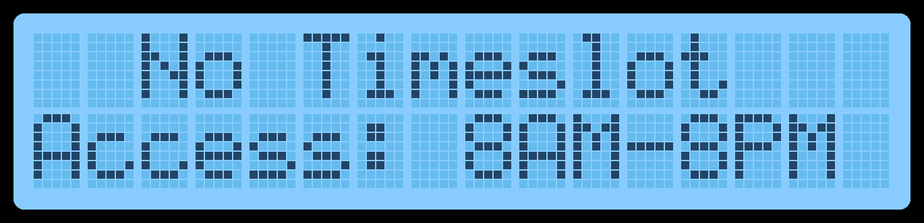
Demo

Slide 17
Q & A

Slide 18
Thank you!

